Slide 1
Course Title: Software Testing And Quality Assurance
Course Code: CSE 4495
Section: A
Our Team Members
Name ID
Al-Momen Reyad 011203011
Md. Abdur Rahman 011202260
Md. Kabirul Hossain 011202026
Sonjoy Dey 011202074

Slide 2
Overview of PHPUnit Testing
#TC | Function | Description | Input Data | Expected Output | Actual Output | Status
TC1 | testAssignLeaveProperties() | Validate leave assignment | Employee: Asif Iqbal, Leave Type: Medical, Leave Date: 2021-10-01 | Date: 2021-10-01, Length: 8 hours, 1 day, Status: 2, Correct Employee, Leave Type | Leave date: 2021-10-01, length: 8 hours, 1 day, status 2, correct employee, leave type | Pass
TC2 | testSetAndGetName() | Test setting and getting education name | Name: Bachelor of Science | Bachelor of Science | Bachelor of Science | Pass
TC3 | testAttendanceRecordEntityPunchIn() | Verifies punch in functionality | PunchInUtcTime: +6:00, PunchInUserTime: 11:00 | State: PUNCH IN | State: PUNCH IN | Pass
TC4 | testLocationEntity() | Validating the Location | Country: BD, Location: Name: Dhaka, Phone: 01521765655 | Country: BD, Location: Name: Dhaka | Country: BD, Location: Name: Dhaka | Pass
TC5 | testAttendanceRecordEntityPunchOut() | Verifies punch out functionality | PunchInUtcTime: +6:00, PunchOutUserTime: 18:00 | State: PUNCH OUT | State: PUNCH OUT | Pass
Notes:
R

Slide 3
Overview of PHPUnit Testing
#TC | Function | Description | Input Data | Expected Output | Actual Output | Status
TC6 | testSetAndGetCountryName() | Verifies that the country name | Name: "Bangladesh | Bangladesh | Bangladesh | Pass
TC7 | testGetCountryList() | Verifies that a list of countries is retrieved correctly |  | Bangladesh, India… | Bangladesh, India… | Pass
TC8 | testLoginLogEntity() | Verifies that the LoginLog entity stores correct user data and login time | DateTime: 2022-07-04 10:56:56, userId: 1, userName: 'username', userRole: 'Admin' | userName: 'username', UserRole: 'Admin' Login Time: 2022-07-04 10:56 | userName: 'username', UserRole: 'Admin' Login Time: 2022-07-04 10:56 | Pass
TC9 | testGetTotalActiveEmployeeCount() | The total active employee count |  | 4 | 4 | Pass
TC10 | testGetLatestAttendanceRecordByEmpNumber () | Fetching the latest attendance record for an employee | Employee number: 2 | State: PUNCHED IN - PunchIn UTC: '2024-09-06 09:15:00' | State: PUNCHED IN - PunchIn UTC: '2024-09-06 09:15:00' | Pass

Slide 4
Unit Testing: Test Assign Leave (TC1)
Objective: Validate that the properties of the Leave entity are correctly assigned and associated with relevant entities (Employee Name, Leave Type, Date etc)
Preconditions:
A user must be logged in to the OrangeHRM system.
A leave type (Medical, Parental) must be configured in the system.
Workflow:
Login
Leave
Assign Leave
Assigned All Entities
(Name, Leave Type, Date)
Assign

Slide 5
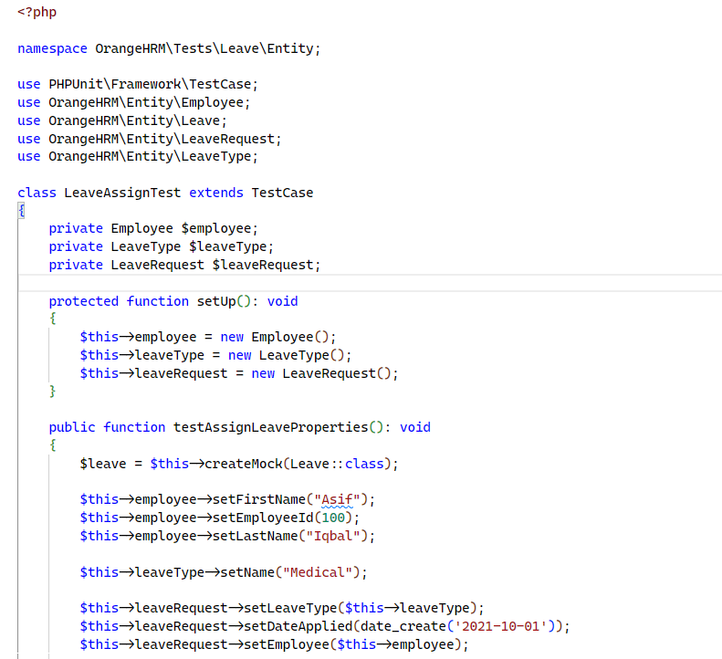
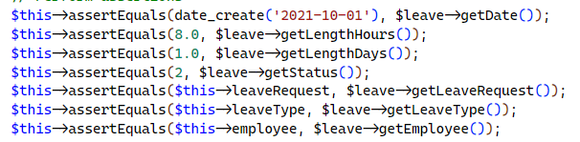
Test Assign Leave (TC1)
Output: PS C:\xampp\htdocs\orangehrm-5.7 (2)\orangehrm-5.7> .\vendor\bin\phpunit --testsuite Leave
PHPUnit 11.3.6 by Sebastian Bergmann and contributors.
Runtime: PHP 8.2.4
Configuration: C:\xampp\htdocs\orangehrm-5.7 (2)\orangehrm-5.7\phpunit.xml 1/1 (100%)
Time: 00:00.051, Memory: 10.00 MB
Tests: 1, Assertions: 8, PHPUnit Deprecations: 1.

Slide 6
#TC | TC Scenario | TC Steps | Expectation | Observation | Risk
TC01 | To check the given access control to the users for application | (Recruitment) | Log in (as hiring manager) → Create a vacancy post → Apply for the vacancy as a candidate → Log out → Log in as a regular user → Attempt to accept/reject the application. | Only the hiring manager should be able to accept/reject the application | Hiring manager, and Admin can accept/reject the application; other user cant. | None
TC02 | To perform the purge action to all users and vacancy posts | (Maintenance) | Start EtterCap → Scan hosts → Select gateway and target machine (as target 1, and 2) → Click ARP Poisoning → Get credentials → Login as admin → Purge all users’ info and posts | Password & uname should not be shown in the console if provided by user | No output observed in the console | None
TC03 |  | Start ZAP → Scan and intercept requests (Ajax spider) → Look for token → Extract credentials → Login as admin → Purge all users’ info and posts | Credential info should be encrypted | Plain uname & pswd found in the response token | Yes
TC04 | To check unauthorized update of users’ info | (PIM) | Start proxy in ZAP → Login (as non-admin) → PIM → Employee List → Access users info → Capture this request in ZAP → Modify request → Resend request → Check if info is changed | Non-admin users shouldn’t be able to update any info of other users | Info can’t be updated by non-admin users | None
TC05 | To view other users’ personal info as non-admin user | (PIM) | Get url of any user → Set ZAP Requester giving the url → Iterate for other users (as non-admin access) → View info | Others private info shouldn’t be visible to non-admin | Info is not visible to non-admin users | None

Slide 7
#TC | TC Scenario | TC Steps | Expectation | Observation | Risk
TC06 | To upload vulnerable XSS payloads in the file attachment | (My Info) | My Info → Personal Details → Attachments → Add executable payload → Save → Try to execute the file | Executable file should not be allowed to be uploaded | Cannot upload executable file | None
TC07 | To insert with improper file name to do Path Traversal Attacks | (My Info) | Start ZAP intercept → My Info → Personal Details → Attachments → Upload a jpg picture (as it’s acceptable) → Intercept the request → Modify file name to different path → Send request → Check if the file is modified and accessible | Shouldn’t be allowed to modify the content with different traversal path | Content can be updated but still needed predefined extensions (i.e., jpg, png, etc) | None
TC08 | To check SQL injection vulnerability | (Login) | Login page → Enter different SQL injection payloads in the uname/pswd field → Check if login is successful | SQL injections shouldn’t be allowed to be executed | Fails to login by SQL injection | None
TC09 | To check for bruteforce attempts vulnerability | (Login) | Open browser (from ZAP) as Intruder → Get a valid uname → Tool → Option → Authentication → Position → Add payloads (pswd) → Start attack | Multiple attempts from a same uname should cause the account lockout (or ask to try later) | Nothing happened (after 10 reqs) | Yes
TC10 | To check user creation with malicious entries | (Employee Information) | Login → PIM → Add (employee) → Enter malicious texts as name → Check if it fails/succeeds | Should reject the user creation attempt if invalid text is provided | Allows malicious entries as First/Last name | Yes

Slide 8
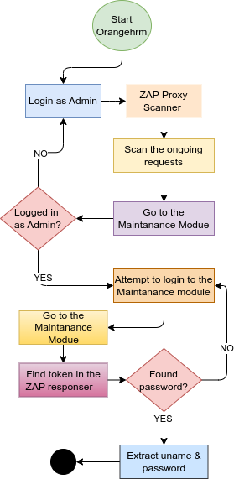
Case Study: TC03 Purge all users and vacancy posts
Introduction: Goal for this TC was to check the security vulnerability in performing the the purge action to all users and vacancy posts in the Maintenance module.
Concept: A second login field exists inside the Maintenance module, and whoever has access to module’s password can purge all info related to the user/posts. The target is to get that credential
Assumptions:
Admin is logged in to the system
Admin is trying to login to the Maintenance portal
Observation:
Scanned requests returned token while Admin was trying to login
Request contained token with uname, and password field
Neither the uname, not the password was encrypted
Risk: Yes (as anyone with a req scanner can get the credential and perform unauthorized actions)
N.B. It was tested in the local env (w/o https protocol)

Slide 9

Features Selected for Testing
1. Login
2. Dashboard
3. Admin Control panel
4. Add employee
5. Directory
6. Notification
7. Recruitment
8. Claim
9. Profile setting
10. Employee claim
11. View Candidates
Testing
1. Load Testing
2. Stress Testing
3. Spike Testing
4. Concurrency Testing

Slide 10
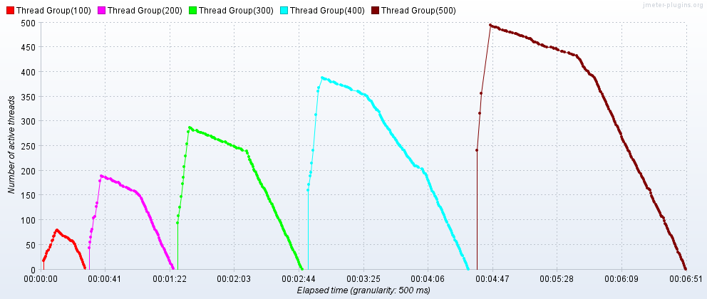
Load Testing
Test: Performing login admin and view system user
Thread Group: 100-500
Ramp Up Time:10s
Aggregate Report
Active Thread Over Time
Thread | Avg | Error % | Throughput | Receive KB/s | Sent KB/s
100 | 13542 | 0.00 | 3.5/s | 17.15 | 1.04
200 | 33773 | 0.00 | 3.6/s | 17.45 | 1.06
300 | 51229 | 0.00 | 3.7/s | 17.56 | 1.08
400 | 64939 | 0.00 | 3.8/s | 18.31 | 1.11
500 | 90962 | 0.00 | 3.6//s | 17.3 | 1.06

Slide 11
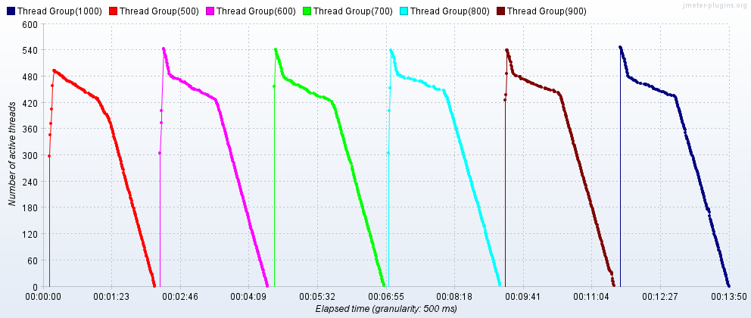
Stress Testing
Test: Performing view user profile
Thread Group: 500-1000
Ramp Up Time:10s
Aggregate Report
Active Thread Over Time
Thread | Avg | Error % | Throughput | Receive KB/s | Sent KB/s
500 | 88249 | 0.00 | 3.7/s | 17.97 | 1.04
600 | 75923 | 17.6 | 4.4/s | 20.11 | 1.12
700 | 68112 | 30.4 | 5.0/s | 21.18 | 1.07
800 | 60296 | 38.0 | 5.7/s | 23.16 | 1.09
900 | 51924 | 45.5 | 6.5/s | 25.41 | 1.10
1000 | 47134 | 51.6 | 7.2//s | 27.13 | 1.10

Slide 12
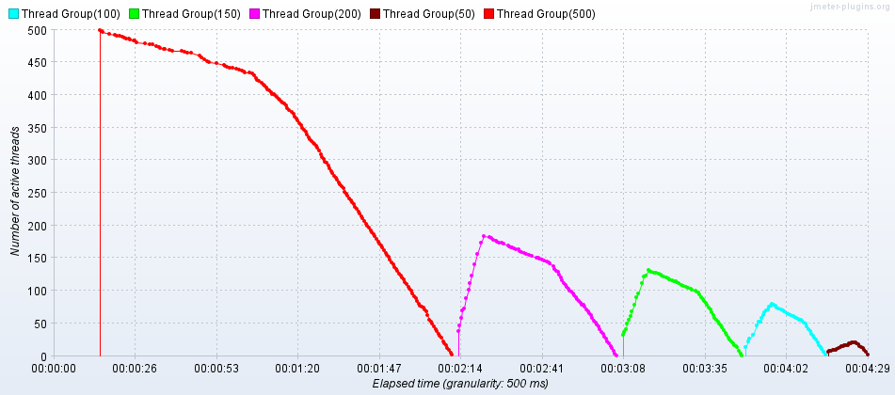
Spike Testing
Test: Performing Recruitment and View Candidates
Thread Group: 50,100,150,200,500
Ramp Up Time:10s
Time Period : 2min After the First load ,then maintained 4s for each thread group
Aggregate Report
Active Thread Over Time
Thread | Avg | Error % | Throughput | Receive KB/s | Sent KB/s
50 | 3506 | 0.00 | 3.6/s | 17.36 | 1.07
100 | 13151 | 0.00 | 3.6/s | 17.55 | 1.08
150 | 22250 | 0.00. | 3.6/s | 17.55 | 1.08
200 | 31167 | 0.00 | 3.7/s | 17.84 | 1.10
500 | 88030 | 18.3 | 1.6//s | 7.25 | 0.41

Slide 13
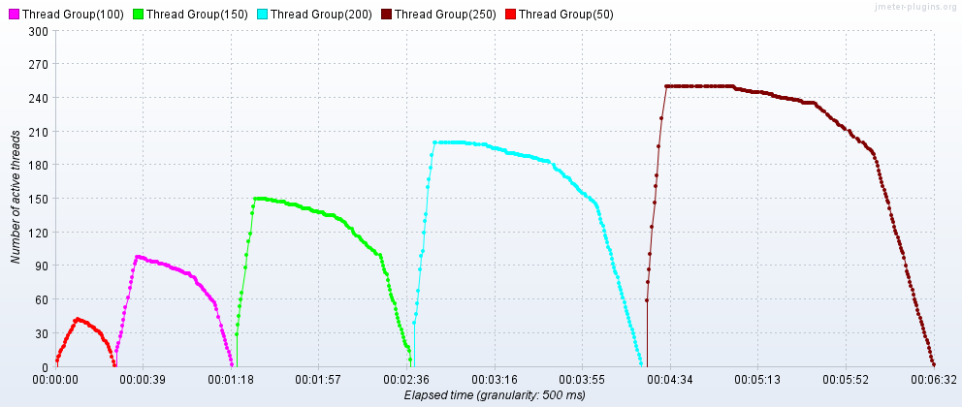
Concurrency Testing
Test: Performing claim and employee claims
Thread Group: 50,100,150,200,250
Ramp Up Time:10s
Aggregate Report
Active Thread Over Time
Thread | Avg | Error % | Throughput | Receive KB/s | Sent KB/s
50 | 7293 | 0.00 | 3.8/s | 18.33 | 1.11
100 | 18325 | 0.00 | 3.8/s | 18.44 | 1.11
150 | 29862 | 0.00. | 3.8/s | 18.29 | 1.10
200 | 39969 | 0.00 | 3.9/s | 18.86 | 1.14
250 | 51904 | 0.00 | 3.8//s | 18.61 | 1.12

Slide 14
Overview of Selenium Testing
#TC | TC Scenario | TC Steps | Expected Outcome | Observed Result | Verdict
TC01 | To check Add Employee feature in the PIM module works correctly. | Login → Navigate to PIM → Add Employee → Fill require details → Click save button → Logout. | Employee data is added to the employee list | Successfully add Employees data and store in the system. | Pass
TC02 | To check employee search function by name or ID operates smoothly and retrieves the correct data. | Login → Navigate to PIM → Select Employee list →Search by exist name or ID → click search button → Verify → Logout. | Validate Data Retrieval. | Record Found | Pass
TC03 | To ensure the functionality of the employee deletion process | Login → Navigate to PIM → Select Employee List → Search employee by name → Click search button → delete employee → Logout | Employee should be deleted from the employee list | Employee data deleted successfully. | Pass
TC04 | To verify that users can successfully apply for leave through the Leave module. | Login → Navigate to Leave → apply for leave → logout. | Test apply for leave | Leave application is successfully submitted | Pass
TC05 | To check if the process of defining and saving time | Login → navigate to Time → Define Time → Click to save → logout. | Validate the clock-in and clock-out feature | Clock in and Clock out is successful | Pass

Slide 15
#TC | TC Scenario | TC Steps | Expected Outcome | Observed Result | Verdict
TC06 | To verify that a new job vacancy can be successfully created through the Recruitment section. | Login → navigate to Recruitment → create new job vacancy → logout. | Create job vacancy | New job vacancy is successfully created | Pass
TC07 | To check if users can smoothly navigate to the Vacancy section and update job vacancy details | Login → navigate to Recruitment → Vacancy → Edit Job Vacancy Details → Logout | Edit details job vacancy | Job vacancy details are edited successfully | Pass
TC08 | To validate that the system allows accurate sorting of employees in ascending order based on their names. | Login → Navigate to PIM → Select Employee List → Sort Employees Ascending order using by Name → Logout | Sort Employees Name ascending order. | Sort Employees name successfully | Pass
TC09 | To ensure the functionality of updating the performance evaluation form works as expected. | Login → navigate to performance → update performance evaluation form → logout. | Assess the updating procedure for the performance evaluation form | The performance evaluation form update was applied without any issues | Pass
TC10 | To Check leave transactions history. | Login → navigate leave → view leave transactions history → logout. | Validate the leave transaction history viewing feature | The leave transactions history is displayed correctly. | Pass

Slide 16
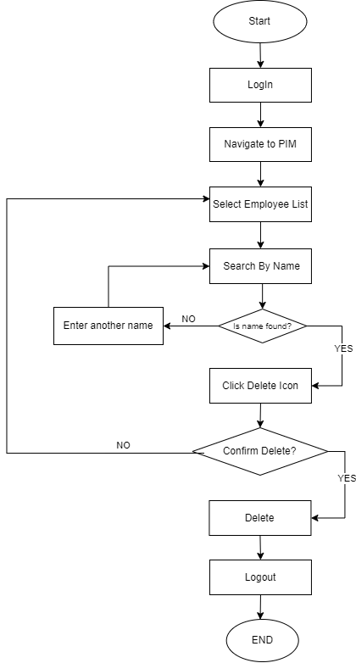
Test Case: TC03
Case Study: Employee Deletion Process in PIM Module
Introduction: This case study assesses the deletion of employee records in the PIM module, ensuring HR can search, delete, and confirm the removal smoothly and without errors.
Challenges:
User Errors: Mistakenly deleting an employee record is a major concern. To prevent this, the system should provide clear confirmation prompts and double-checks before finalizing the deletion.
Authorization: Only authorized personnel should delete employee records. The system must enforce access controls to prevent unauthorized users from initiating the deletion process.
System Feedback: Users need confirmation of successful deletion; without it, they may think the action failed, causing confusion or repeated attempts.
FlowChart

Slide 17




Work Distribution
Al-Momen Reyad
Abdur Rahman
Md. Kabirul Hossain
Sonjoy Dey

Slide 18
Thank You

